Slide 1
Gravity Wave Horizontal Wavelength determination
Presented by:
Sree Nirmillo Biswash Tushar
Graduate Student,
Department of Electrical and Computer Engineering
University of Alaska, Fairbanks

Slide 2
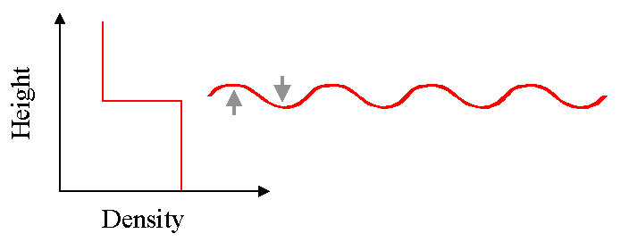
Gravity Waves
Waves may occur in any medium in which the density decreases with height. If the restoring force is gravity, these waves are called gravity waves.

Slide 3
Why GW parameterization?
Gravity waves carry momentum and energy between different points in the atmosphere and they can alter the mean flow.
Meteorologists: Computer models are not always very good at predicting mean winds or making good forecasts.
Reason: Part of the reason for this is that they had not been including gravity wave generation and dissipation in their models.
Therefore,
A considerable amount of effort is being turned towards proper parameterization of gravity waves in meteorological models.

Slide 4
Challenges and Prospects
Challenge:
Gravity wave has a broad spectrum of frequency, horizontal and vertical wavelength which has made it difficult to extract from global dataset. [3]
Not enough resolution or footprint to detect GW [3]
Prospects:
High resolution images of satellite along with innovative data processing techniques has created some global datasets describing temperature variation with gravity waves. [3]

Slide 5
Previous Works
GWs parameterization forced by convection (convective heating depth, convective heating rate, and the background wind) [1]
Satellite temperature variance maps have been used to find out convectively generated gravity waves [2]
Alexander et al introduced an new wavelet based statistical technique to find out the parameter of a gravity wave [3]
The authors present a configuration of the Whole Atmosphere Community Climate Model (WACCM) that replaces the arbitrarily specified GW source spectrum with GW source parameterizations [4].

Slide 6
AIRS History and Objective
The atmospheric infrared sounder (AIRS) is one of six instruments flying on board NASA's Aqua satellite (Sun Synchronous, orbital period 16 days), launched on May 4, 2002.
It works along with Advanced Microwave Sounding Unit (AMSU) and the Microwave Humidity Sounder (MHS).
To support climate research and improve weather forecasting.

Slide 7
AIRS Data Collection Method
The Atmospheric Infrared Sounder (AIRS) is a cross-track scanning instrument.
Scan mirror rotates around an axis along the line of flight and directs infrared energy from the Earth into the instrument.
A scan 'swath' that extends roughly 800 km on either side of the ground track. So, 1600 km swath.
Each granules are 90 (cross track)*135 (along track) samples.
The infrared energy is separated into wavelengths, sent the Aqua spacecraft, which relays it to the ground.

Slide 8
AIRS Data Collection
Sounder means temperature and water vapor are measured as functions of height.
Detects ozone, carbon monoxide, carbon dioxide, methane, and sulfur dioxide, and dust particles.
AIRS measures the infrared brightness coming up from Earth's surface and from the atmosphere's constituent.
Each infrared wavelength is sensitive to temperature and water vapor over a range of heights in the atmosphere.
By having multiple infrared detectors, each sensing a particular wavelength, thereby a temperature profile can be made. While prior space instruments had only 15 detectors, AIRS has 2378.

Slide 9
AIRS Data Collection
Provides +/- 49.5 degrees (from nadir) ground coverage every scan cycle. The scan cycle repeats every 8/3 seconds.
Ninety ground footprints in each scan.
2378 spectral samples in each footprint (A ground footprint every 22.4 ms)
The AIRS IR spatial resolution is 13.5 km at nadir from the 705.3 km orbit.
There is also a set of visible and near infrared detectors (Vis/NIR). The Vis/NIR spatial resolution is approximately 2.3 km. The Vis/NIR channels provide a diagnostic imaging capability for observing low-level clouds.
Using space views and on-board blackbody, the science software (running on the ground) calibrates the IR radiances to absolute accuracy 3% or better.

Slide 10
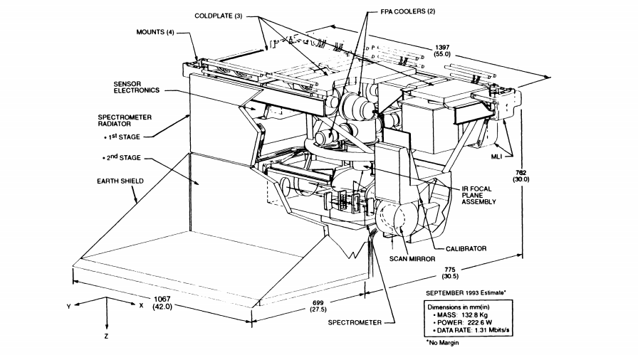
Components in AIRS Instrument

Slide 11
Components in AIRS Instrument
Main Components:
A four-color imaging photometer
A multi-aperture spectrometer
Vis/NIR detector
A four-color imaging photometer
convert light into an electric current using a photoresistor, photodiode, or photomultiplier, then measures electromagnetic radiation in the range from ultraviolet to infrared and including the visible spectrum.

Slide 12
A multi-aperture spectrometer
Passively cooled to about 155 K by a two-stage radiator assembly.
The IR spectrometer has eleven separate apertures, grating of 13 lines/mm, each of which is eventually imaged onto the focal plane.
Grating disperses the light into its component wavelengths.
A combination of filters at the 11 apertures, orders of the gratings and order-separation filters on the focal plane ensures that each IR detector is exposed to light from just one well-known narrow band of wavelengths.

Slide 13
Vis/NIR detector
12 modules containing 17 linear arrays distributed in a two-dimensional pattern.
Two types:
(1) photovoltaic (PV)
(2) photoconductive (PC).
It was originally hoped that the entire focal plane could be PV, But PV detectors sensitive to the longest AIRS wavelengths were not available by the time the instrument designed.
So two of the twelve detector modules (for 13.7 to 15.4 micron wavelengths) are PC.

Slide 14
Data Choosing
75th channel is selected because of GW perturbation appears in 15-4.3 micrometer emission band
L1B Data (Products containing geolocated and calibrated spectral radiance and solar irradiance data.)
Altitude 35 kilometers (GW is generally strong at this altitude).
First step is filtering the background noise [1] by a fourth order polynomial fit.

Slide 15
Filtering Background Noise
AIRS.2018.12.24.121.L1B

Slide 16
Filtering Background Noise
AIRS.2018.12.24.122.L1B

Slide 17
Filtering Background Noise

Slide 18
Interpolation
FFT requires equal space between points.
Make equal latitude and space between two points.
Spline is used to better performance .

Slide 19
Interpolation
Latitude difference: 3 degree, Longitude difference: 15 degree

Slide 20
2D-FFT
Converted the Latitude, Longitude into Physical Distance
FFT gives wavenumber when the wave is a spatial wave
[Cos(-(2*pi)/0.01)X-((-(2*pi)/0.05)Y)

Slide 21
2D-FFT

Slide 22
Horizontal Wave Calculation
Kx=2.7 micrometer
Lemdax=370 kilometer (Approximately)
Ky=0.94 micrometer
Lemdax=1059 kilometer (Approximately)
Lemda=1121 kilometer (too much)

Slide 23
References
[1] Hartmut H. Aumann and Christopher R. Miller "Atmospheric infrared sounder (AIRS) on the earth observing system", Proc. SPIE 2583, Advanced and Next-Generation Satellites, (15 December 1995).
[2] Richter, Jadwiga H., Fabrizio Sassi, and Rolando R. Garcia. "Toward a physically based gravity wave source parameterization in a general circulation model." Journal of the Atmospheric Sciences 67.1 (2010): 136-156.
[3] Wu and J. W. Waters, 1996a: Gravity-wave-scale temperature fluctuations seen by the UARS MLS. Geophys. Res. Lett., 23, 3289–3292.
[4] Alexander, M. Joan, and Christopher Barnet. "Using satellite observations to constrain parameterizations of gravity wave effects for global models." Journal of the atmospheric sciences 64.5 (2007): 1652-1665.
[5] Schirber, Sebastian, Elisa Manzini, and M. Joan Alexander. "A convection‐based gravity wave parameterization in a general circulation model: Implementation and improvements on the QBO." Journal of Advances in Modeling Earth Systems 6.1 (2014): 264-279
[ 6] https://airs.jpl.nasa.gov/mission_and_instrument/instrument
[7] http://www.physics.uwo.ca/~whocking/p103/grav_wav.html
[8] https://en.wikipedia.org/wiki/AIRS

Slide 24
Thank you
Any Question?

